Slide 1
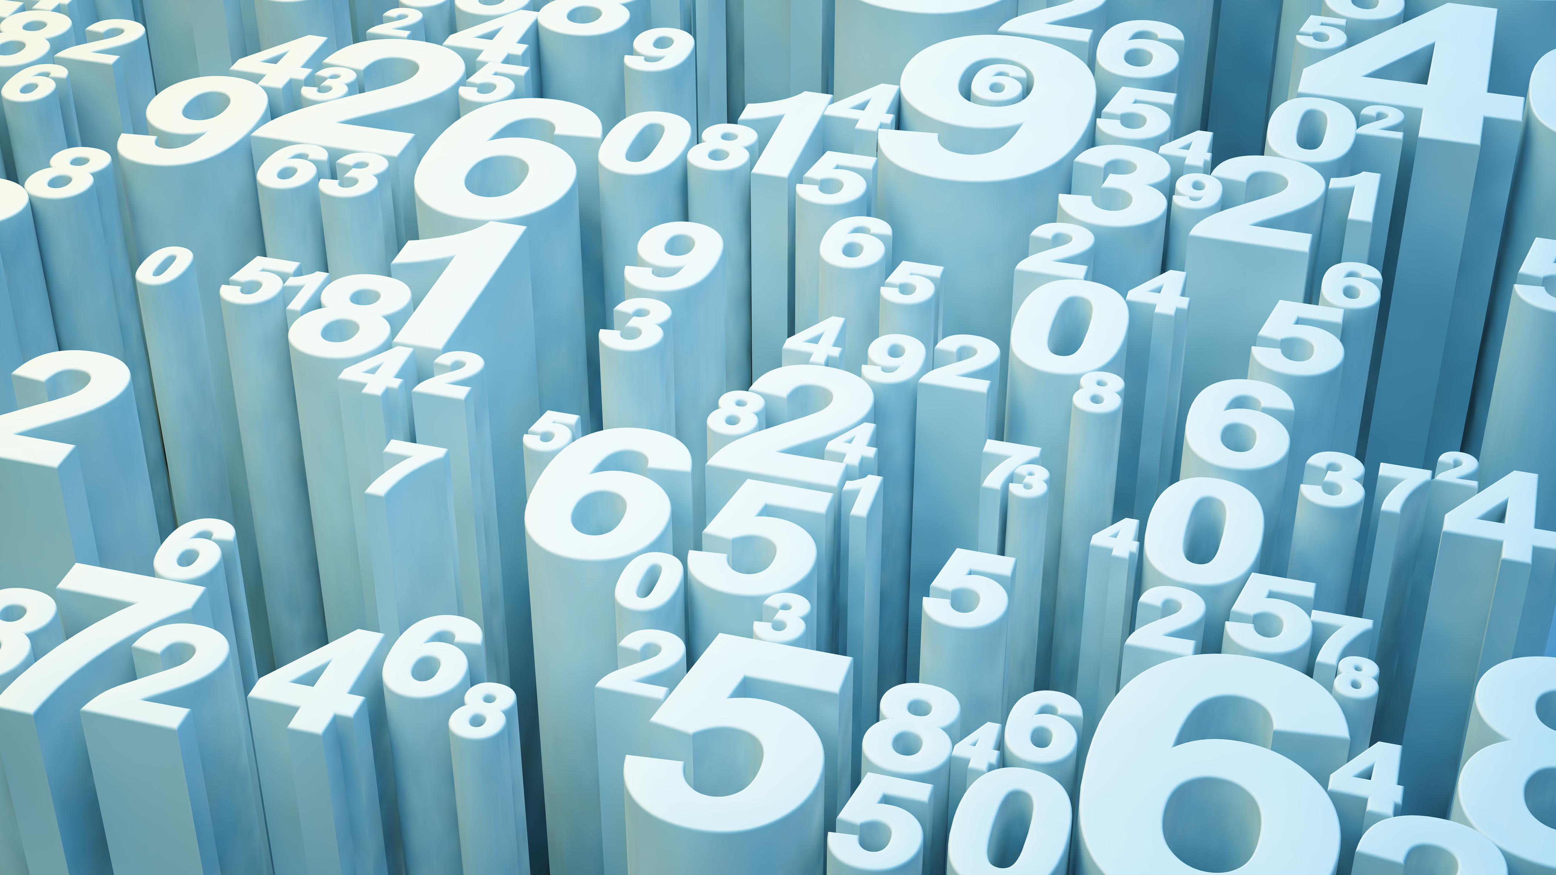
Study of Lausanne’s venues
Lavinia Saccoccio

Slide 2

Overview
Introduction
Libraries used in the project
How does k-Means work
Algorithm :
Pre-processing and cleaning data
One hot encoding
Application of k-Means
Conclusions

Slide 3
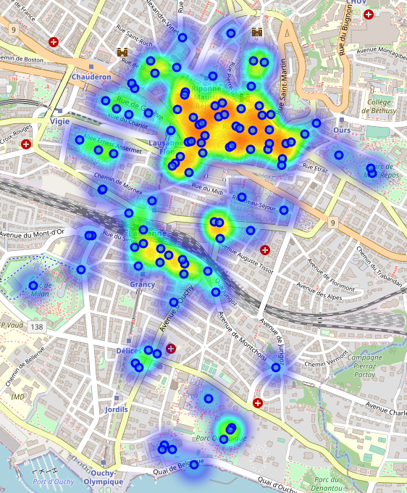
Introduction
The idea is to analyse the city of Lausanne and create clusters of venues that are similar to each other.
First we scrape the venues and get the coordinates, then we clean and analyse the data.

Slide 4
Main libraries used
Json: to handle json files from scraping stage
Pandas: library for data analysis
K-means from Scikit Learn: for clustering stage
NumPy: library to handle data in a vectorized manner
Folium: map rendering library
Matplotlib: for plots
Requests: library to pull requests from the API

Slide 5
How does k-Means work
K-Means aims to partition n observations into k clusters in which each observation belongs to the cluster with the nearest mean (cluster centroid)
K has to be initialised
Each data point is assigned to its nearest centroid, based on the squared Euclidean distance (based on feature similarity)
Used for anomaly detection, image compression, Segmentation

Slide 6
The Algorithm: Foursquare API
We will send GET requests to the Foursquare API in order to get the venues data for the city of Lausanne:
Build the URL, send the GET request and write the source code into a json file
Repeat the scraping process to extract data from the json file: venue name, category, latitude and longitude
Put everything into a new dataframe

Slide 7
The Algorithm: Pre-processing and cleaning
An important task in every project is to make sure data is clean and ready to be analysed.
Filter the dataframe and reset the indices (removes the missing values)
Dropped the column with the venue name
Check and drop any row with a NaN value

Slide 8
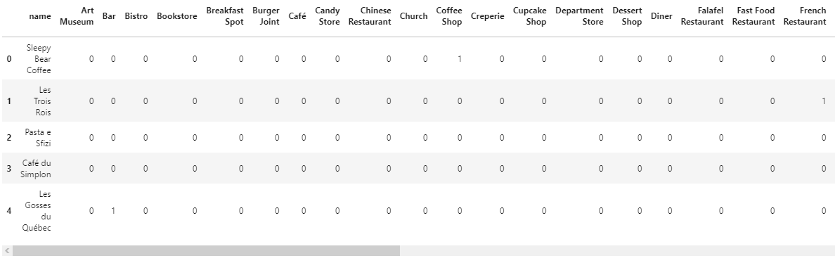
The Algorithm: one hot encoding
In order to run K-Means, we have to transform the dataframe into something that the machine could understand.
One hot encoding is a process by which categorical variables are converted into binary variables (0,1)

Slide 9
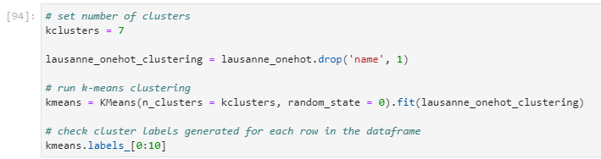
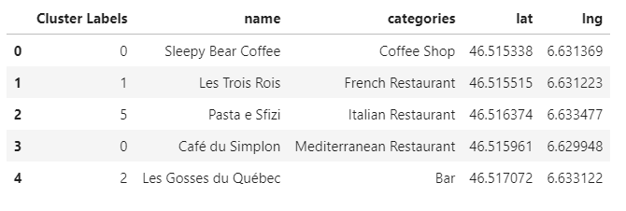
The Algorithm: k-Means
After all the preparations we are ready to run k-Means:
k = 7
And we obtained a dataframe like this one:

Slide 10
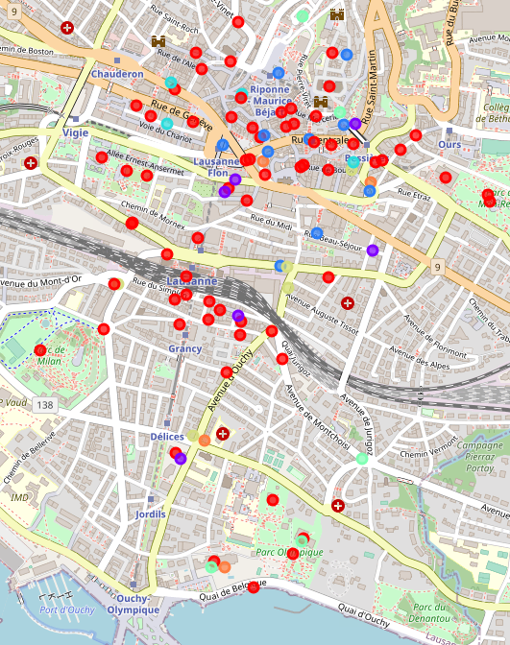
Results
Map before clustering:
After clustering:

